Slide 1
ECE 532
CHAPTER 4: GRAPHS (PART 3: Spanning Tree – Kruskal, Prim algorithms)
Lecturer: Dr. Roslina Mohamad
Room: Tower 2, Level 13, No:14C

Slide 2
Learning Outcomes
In this chapter, you will:
Implement the minimal spanning tree algorithm

Slide 3
Spanning Trees
When graph G is connected, a depth first or breadth first search starting at any vertex will visit all vertices in G
A spanning tree is any tree that consists solely of edges in G and that includes all the vertices
E(G): T (tree edges) + N (nontree edges) where T: set of edges used during search N: set of remaining edges

Slide 4
Spanning trees
Suppose you have a connected undirected graph
Connected: every node is reachable from every other node
Undirected: edges do not have an associated direction
...then a spanning tree of the graph is a connected subgraph with the same nodes in which there are no cycles
A connected, undirected graph
Four of the spanning trees of the graph
Theorem:
A simple graph is connected if it has a spanning tree.

Slide 5
Spanning Trees
A spanning tree of a graph is just a subgraph that contains all the vertices and is a tree.
A graph may have many spanning trees.
Graph A
Some Spanning Trees from Graph A
or
or
or

Slide 6
Complete Graph
All 16 of its Spanning Trees

Slide 7
Graph Representations
Weighted edges
The edges of a graph have weights assigned to them.
These weights may represent as
the distance from one vertex to another
cost of going from one vertex to an adjacent vertex.
adjacency matrix: adj_mat[i][j] would keep the weights.
adjacency lists: add a weight field to the node structure.
A graph with weighted edges is called a network

Slide 8
Minimum Cost Spanning Trees
Introduction
The cost of a spanning tree of a weighted, undirected graph is the sum of the costs (weights) of the edges in the spanning tree.
A minimum-cost spanning tree is a spanning tree of least cost.
Three different algorithms can be used to obtain a minimum cost spanning tree.
Kruskal’s algorithm
Prim’s algorithm
Sollin’s algorithm
All the three use a design strategy called the greedy method

Slide 9
Minimum Cost Spanning Trees
Greedy Strategy
Construct an optimal solution in stages
At each stage, we make the best decision (selection) possible at this time.
using least-cost criterion for constructing minimum-cost spanning trees
Make sure that the decision will result in a feasible solution
A feasible solution works within the constraints specified by the problem
Our solution must satisfy the following constrains
Must use only edges within the graph.
Must use exactly n - 1 edges.
May not use edges that produce a cycle

Slide 10
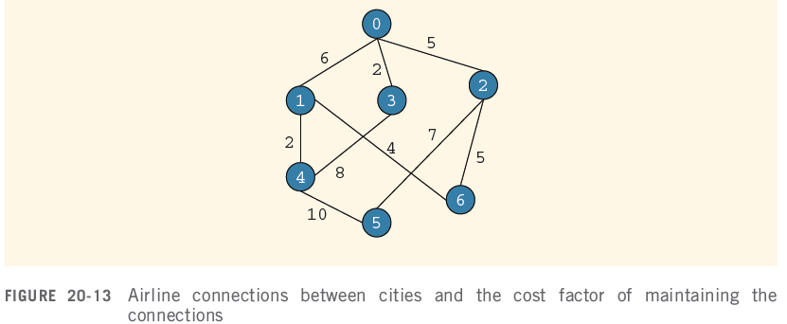
Minimal Spanning Tree Application
Company needs to shut down a maximum number of connections and still be able to fly from one city to another

Slide 11
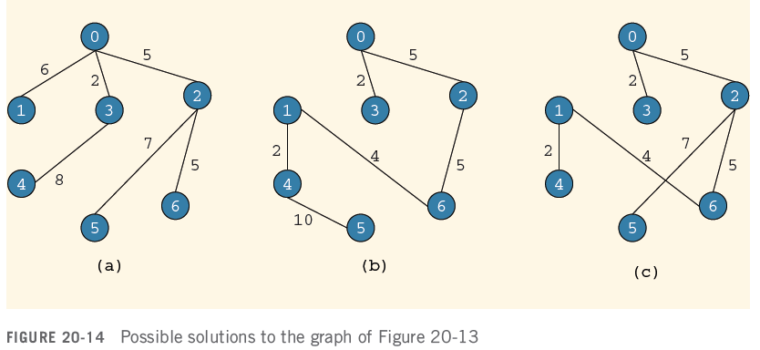
Minimal Spanning Tree Application

Slide 12
Minimum Spanning Trees
The Minimum Spanning Tree for a given graph is the Spanning Tree of minimum cost for that graph.
Complete Graph
Minimum Spanning Tree
7
2
2
5
3
3
4
1
1

Slide 13
Algorithms for Obtaining the Minimum Spanning Tree
Kruskal's Algorithm
Prim's Algorithm

Slide 14
Kruskal's Algorithm
This algorithm creates a forest of trees. Initially the forest consists of n single node trees (and no edges). At each step, we add one edge (the cheapest one) so that it joins two trees together. If it were to form a cycle, it would simply link two nodes that were already part of a single connected tree, so that this edge would not be needed.

Slide 15
The steps are:
1. The forest is constructed - with each node in a separate tree.
2. The edges are placed in a priority queue.
3. Until we've added n-1 edges,
1. Extract the cheapest edge from the queue,
2. If it forms a cycle, reject it,
3. Else add it to the forest. Adding it to the forest will join two trees together.
Every step will have joined two trees in the forest together, so that at the end, there will only be one tree in T.

Slide 16
Complete Graph
B
4
C
4
2
1
A
4
E
1
F
D
2
3
10
G
5
5
6
3
4
I
H
2
3
J

Slide 17
A
4
B
A
1
D
B
4
C
B
4
D
B
4
C
B
10
J
C
2
E
4
2
1
C
1
F
D
5
H
A
4
E
1
F
2
D
6
J
E
2
G
D
3
10
G
5
F
3
G
F
5
I
5
6
3
4
I
G
3
I
G
4
J
H
2
3
J
H
2
J
I
3
J

Slide 18
Sort Edges
(in reality they are placed in a priority queue - not sorted - but sorting them makes the algorithm easier to visualize)
1
1
A
D
C
F
C
2
E
E
2
G
B
4
C
H
2
J
F
3
G
4
2
1
G
3
I
I
3
J
A
4
E
1
F
2
A
4
B
B
4
D
D
3
10
G
5
B
4
C
G
4
J
5
6
3
4
I
F
5
I
D
5
H
H
2
3
J
D
6
J
B
10
J

Slide 19
Add Edge
1
1
A
D
C
F
C
2
E
E
2
G
B
4
C
H
2
J
F
3
G
4
2
1
G
3
I
I
3
J
A
4
E
1
F
2
A
4
B
B
4
D
D
3
10
G
5
B
4
C
G
4
J
5
6
3
4
I
F
5
I
D
5
H
H
2
3
J
D
6
J
B
10
J

Slide 20
Add Edge
1
1
A
D
C
F
C
2
E
E
2
G
B
4
C
H
2
J
F
3
G
4
2
1
G
3
I
I
3
J
A
4
E
1
F
2
A
4
B
B
4
D
D
3
10
G
5
B
4
C
G
4
J
5
6
3
4
I
F
5
I
D
5
H
H
2
3
J
D
6
J
B
10
J

Slide 21
Add Edge
1
1
A
D
C
F
C
2
E
E
2
G
B
4
C
H
2
J
F
3
G
4
2
1
G
3
I
I
3
J
A
4
E
1
F
2
A
4
B
B
4
D
D
3
10
G
5
B
4
C
G
4
J
5
6
3
4
I
F
5
I
D
5
H
H
2
3
J
D
6
J
B
10
J

Slide 22
Add Edge
1
1
A
D
C
F
C
2
E
E
2
G
B
4
C
H
2
J
F
3
G
4
2
1
G
3
I
I
3
J
A
4
E
1
F
2
A
4
B
B
4
D
D
3
10
G
5
B
4
C
G
4
J
5
6
3
4
I
F
5
I
D
5
H
H
2
3
J
D
6
J
B
10
J

Slide 23
Add Edge
1
1
A
D
C
F
C
2
E
E
2
G
B
4
C
H
2
J
F
3
G
4
2
1
G
3
I
I
3
J
A
4
E
1
F
2
A
4
B
B
4
D
D
3
10
G
5
B
4
C
G
4
J
5
6
3
4
I
F
5
I
D
5
H
H
2
3
J
D
6
J
B
10
J

Slide 24
Cycle
Don’t Add Edge
1
1
A
D
C
F
C
2
E
E
2
G
B
4
C
H
2
J
F
3
G
4
2
1
G
3
I
I
3
J
A
4
E
1
F
2
A
4
B
B
4
D
D
3
10
G
5
B
4
C
G
4
J
5
6
3
4
I
F
5
I
D
5
H
H
2
3
J
D
6
J
B
10
J

Slide 25
Add Edge
1
1
A
D
C
F
C
2
E
E
2
G
B
4
C
H
2
J
F
3
G
4
2
1
G
3
I
I
3
J
A
4
E
1
F
2
A
4
B
B
4
D
D
3
10
G
5
B
4
C
G
4
J
5
6
3
4
I
F
5
I
D
5
H
H
2
3
J
D
6
J
B
10
J

Slide 26
Add Edge
1
1
A
D
C
F
C
2
E
E
2
G
B
4
C
H
2
J
F
3
G
4
2
1
G
3
I
I
3
J
A
4
E
1
F
2
A
4
B
B
4
D
D
3
10
G
5
B
4
C
G
4
J
5
6
3
4
I
F
5
I
D
5
H
H
2
3
J
D
6
J
B
10
J

Slide 27
Add Edge
1
1
A
D
C
F
C
2
E
E
2
G
B
4
C
H
2
J
F
3
G
4
2
1
G
3
I
I
3
J
A
4
E
1
F
2
A
4
B
B
4
D
D
3
10
G
5
B
4
C
G
4
J
5
6
3
4
I
F
5
I
D
5
H
H
2
3
J
D
6
J
B
10
J

Slide 28
Cycle
Don’t Add Edge
1
1
A
D
C
F
C
2
E
E
2
G
B
4
C
H
2
J
F
3
G
4
2
1
G
3
I
I
3
J
A
4
E
1
F
2
A
4
B
B
4
D
D
3
10
G
5
B
4
C
G
4
J
5
6
3
4
I
F
5
I
D
5
H
H
2
3
J
D
6
J
B
10
J

Slide 29
Add Edge
1
1
A
D
C
F
C
2
E
E
2
G
B
4
C
H
2
J
F
3
G
4
2
1
G
3
I
I
3
J
A
4
E
1
F
2
A
4
B
B
4
D
D
3
10
G
5
B
4
C
G
4
J
5
6
3
4
I
F
5
I
D
5
H
H
2
3
J
D
6
J
B
10
J

Slide 30
Minimum Spanning Tree
Complete Graph
B
4
C
4
B
C
4
4
2
1
2
1
A
E
A
4
1
F
E
F
1
D
2
2
D
3
10
G
G
5
3
5
6
3
4
I
I
H
H
2
3
3
J
2
J

Slide 31
Examples for Kruskal’s Algorithm
10
0 5
2 3
1 6
1 2
3 6
3 4
4 6
4 5
0 1
12
14
0
0
0
28
16
1
1
10
1
10
14
16
18
6
2
5
6
2
5
6
2
5
24
22
25
18
12
4
4
4
22
3
3
3
24
25
28

Slide 32
0 5
2 3
1 6
1 2
3 6
3 4
4 6
4 5
0 1
10
12
14
16
0
0
0
10
1
10
1
10
1
18
14
14
16
22
5
6
2
5
6
2
5
6
2
12
12
12
24
4
4
4
3
3
3
25
28
+
3 6

Slide 33
0 5
2 3
1 6
1 2
3 6
3 4
4 6
4 5
0 1
10
12
14
0
0
16
10
1
10
1
18
14
16
14
16
5
6
2
5
6
2
22
25
12
12
4
4
24
22
+
4 6
22
3
3
25
cycle
cost = 10 +25+22+12+16+14
28

Slide 34
Example program
Example 4.11

Slide 35
Prim's Algorithm
This algorithm starts with one node. It then, one by one, adds a node that is unconnected to the new graph to the new graph, each time selecting the node whose connecting edge has the smallest weight out of the available nodes’ connecting edges.

Slide 36
The steps are:
1. The new graph is constructed - with one node from the old graph.
2. While new graph has fewer than n nodes,
1. Find the node from the old graph with the smallest connecting edge to the new graph,
2. Add it to the new graph
Every step will have joined one node, so that at the end we will have one graph with all the nodes and it will be a minimum spanning tree of the original graph.

Slide 37
Complete Graph
B
4
C
4
2
1
A
4
E
1
F
D
2
3
10
G
5
5
6
3
4
I
H
2
3
J

Slide 38
Old Graph
New Graph
B
4
C
4
B
4
C
2
1
4
2
1
A
4
E
1
F
A
4
E
F
1
D
2
3
10
D
2
3
G
5
10
G
5
5
6
3
5
6
3
4
I
4
H
I
3
H
2
J
2
3
J

Slide 39
Old Graph
New Graph
B
4
C
4
B
4
C
2
1
4
2
1
A
4
E
1
F
A
4
E
F
1
D
2
3
10
D
2
3
G
5
10
G
5
5
6
3
5
6
3
4
I
4
H
I
3
H
2
J
2
3
J

Slide 40
Old Graph
New Graph
B
4
C
4
B
4
C
2
1
4
2
1
A
4
E
1
F
A
4
E
F
1
D
2
3
10
D
2
3
G
5
10
G
5
5
6
3
5
6
3
4
I
4
H
I
3
H
2
J
2
3
J

Slide 41
Old Graph
New Graph
B
4
C
4
B
4
C
2
1
4
2
1
A
4
E
1
F
A
4
E
F
1
D
2
3
10
D
2
3
G
5
10
G
5
5
6
3
5
6
3
4
I
4
H
I
3
H
2
J
2
3
J

Slide 42
Old Graph
New Graph
B
4
C
4
B
4
C
2
1
4
2
1
A
4
E
1
F
A
4
E
F
1
D
2
3
10
D
2
3
G
5
10
G
5
5
6
3
5
6
3
4
I
4
H
I
3
H
2
J
2
3
J

Slide 43
Old Graph
New Graph
B
4
C
4
B
4
C
2
1
4
2
1
A
4
E
1
F
A
4
E
F
1
D
2
3
10
D
2
3
G
5
10
G
5
5
6
3
5
6
3
4
I
4
H
I
3
H
2
J
2
3
J

Slide 44
Old Graph
New Graph
B
4
C
4
B
4
C
2
1
4
2
1
A
4
E
1
F
A
4
E
F
1
D
2
3
10
D
2
3
G
5
10
G
5
5
6
3
5
6
3
4
I
4
H
I
3
H
2
J
2
3
J

Slide 45
Old Graph
New Graph
B
4
C
4
B
4
C
2
1
4
2
1
A
4
E
1
F
A
4
E
F
1
D
2
3
10
D
2
3
G
5
10
G
5
5
6
3
5
6
3
4
I
4
H
I
3
H
2
J
2
3
J

Slide 46
Old Graph
New Graph
B
4
C
4
B
4
C
2
1
4
2
1
A
4
E
1
F
A
4
E
F
1
D
2
3
10
D
2
3
G
5
10
G
5
5
6
3
5
6
3
4
I
4
H
I
3
H
2
J
2
3
J

Slide 47
Old Graph
New Graph
B
4
C
4
B
4
C
2
1
4
2
1
A
4
E
1
F
A
4
E
F
1
D
2
3
10
D
2
3
G
5
10
G
5
5
6
3
5
6
3
4
I
4
H
I
3
H
2
J
2
3
J

Slide 48
Complete Graph
Minimum Spanning Tree
B
4
C
4
B
4
C
2
1
4
2
1
A
4
E
1
F
A
E
F
1
D
2
3
10
D
2
G
5
G
5
6
3
3
4
I
H
I
3
H
2
J
2
3
J

Slide 49
Examples for Prim’s Algorithm
0
28
10
1
14
16
5
6
2
24
25
0
18
12
0
0
4
10
1
22
3
1
10
1
10
5
6
2
5
6
2
5
6
2
25
25
4
4
4
3
3
22
3

Slide 50
0
28
10
1
14
16
5
6
2
24
25
18
12
4
22
3
0
0
0
10
1
10
1
10
1
16
14
16
5
6
2
5
6
2
5
6
2
25
25
25
4
12
4
12
4
12
22
3
22
3
22
3

Slide 51
Example
Example 4.12

